Slide 1
Wyatt Kormick
www.github.com/oway13
wyattcody133@gmail.com
218-689-5936

Slide 2
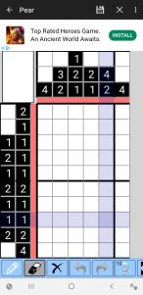
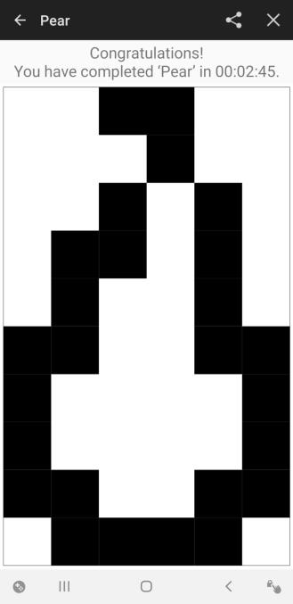
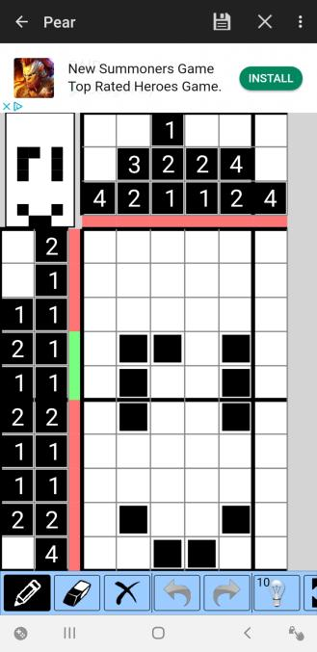
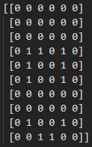
Griddler Solver
Python 3 (March 2019)
Notes:
The idea for the algorithm was to generate every possible solution to a single row and column
If there was a dot marked in every solution, it is safe to mark
You do it for every row and column
After doing it once, it can then generate every possible solution containing the marked dots, so the set should be smaller.
In reality, it makes it through only a few iterations before it stops marking new dots

Slide 3
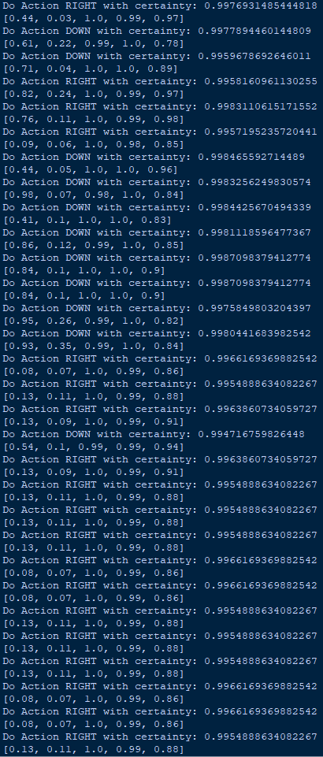

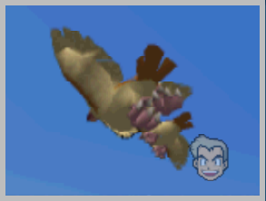
SnapAI (Py3)
Python 3 (April 2018). Genetic Algorithm to refine the values in a neural network to play Pokemon Snap
Notes:
Using my own neural network (next time use a library)
5 children per generation
Top 2 children survive
Various processes to select other three children used
Various processes to score children used
Would find local maxima. The first local is continuously pressing the snap button until out of pictures, resulting in many low quality pictures
When purposely removing that local, it then waits and positions itself to take one perfect picture of a bird (pidgey) as seen in the slide
Video is of a first generation child, so it doesn’t do anything spectacular

Slide 4
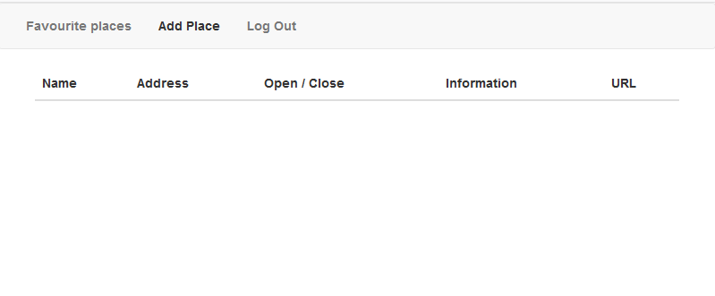
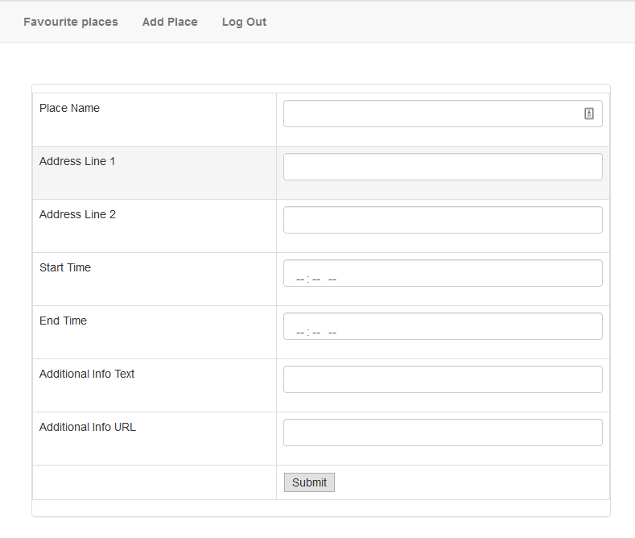
Favorite Places Website
Node.js HTML CSS AJAX MySQL (April 2018)
Notes:
Node.js Server stores and retrieves favorite place data from MySQL server
Uses AJAX to get the place data to the client

Slide 5
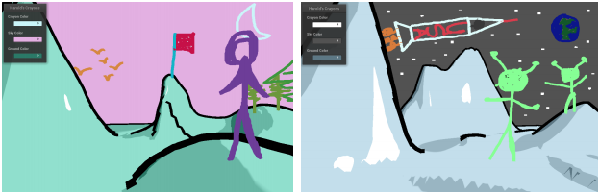
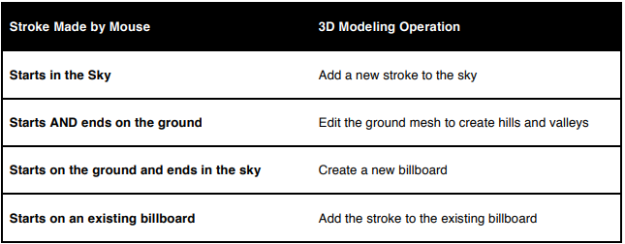
Harold and the Purple Crayon
C++ with Professor’s own graphics engine (April 2018)
Notes:
Implementing an algorithm from a research paper
Pick Rays and their Intersections

Slide 6
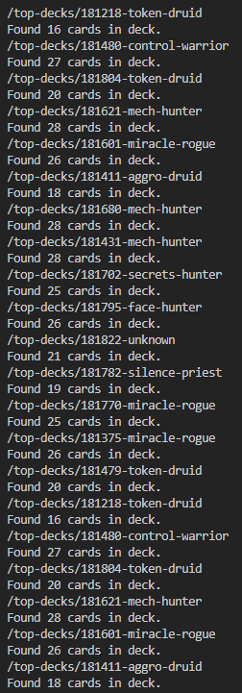
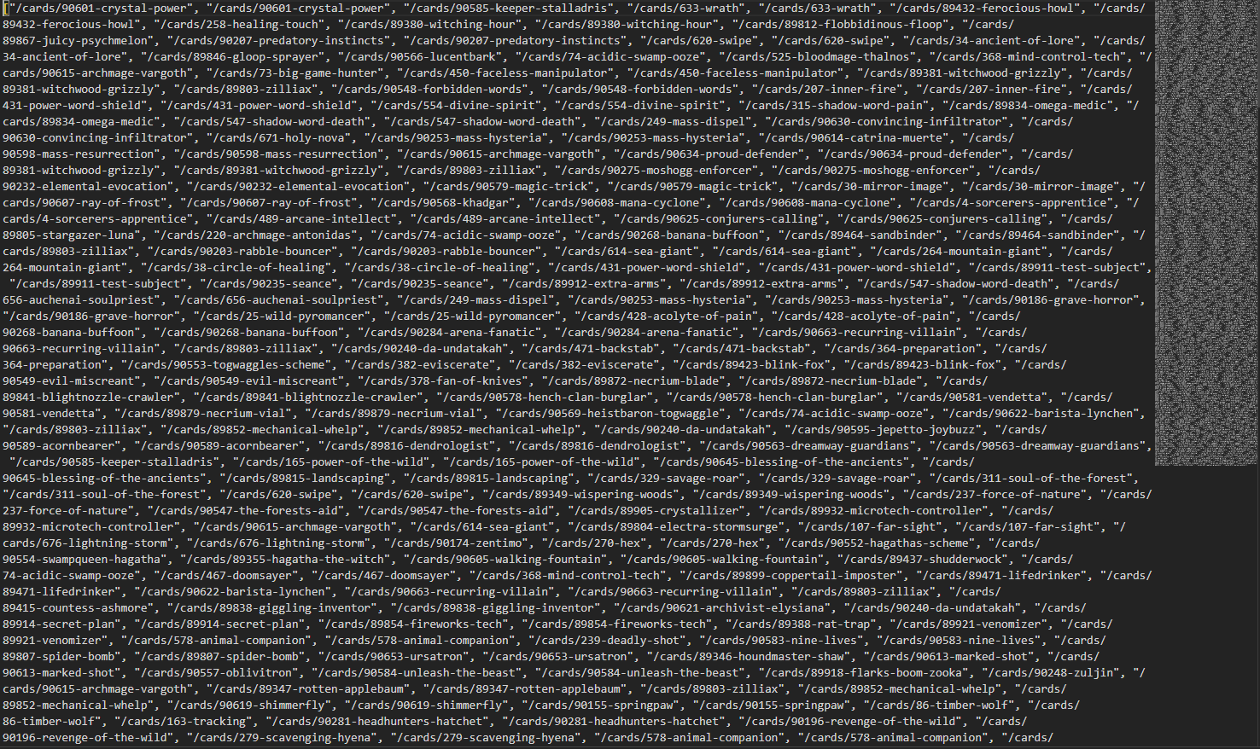
Web Scraper
Python 3 (August 2018)
Notes:
Gets the top X pages worth of user-rated decks
Goes to the web page for each deck and scrapes which cards are in each deck.
Stores the list of cards in a json file
Could be used for generating a data set

Slide 7
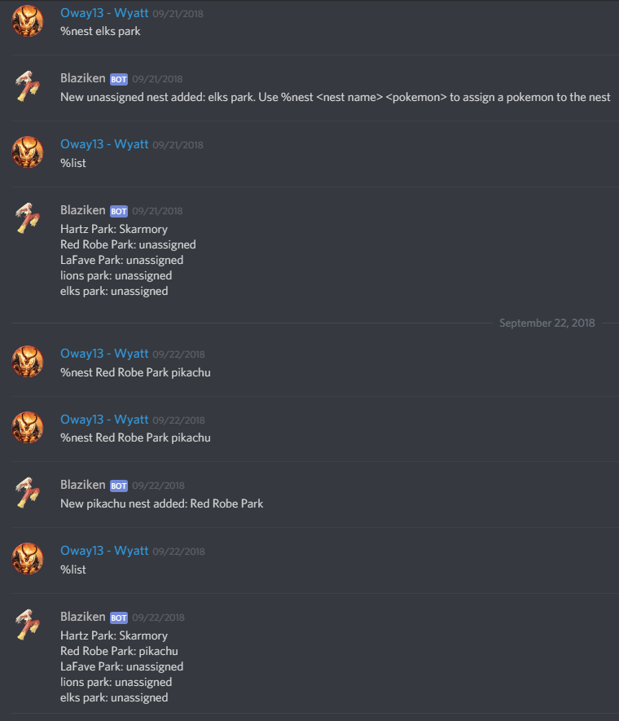
Discord Bot
Python 3 with Discord.py (September 2018)
Notes:
Implements Discord commands to directly edit a json file

